Slide 1

2D Closest Pair Divide And Conquer
Supervised by : Dr. Islam Elshaarawy
Name: Seifeldein Ahmed 223393

Slide 2
Problem Statement:
The problem is to find the closest pair of points from a given set of points in a 2D plane.
The goal is to design an algorithm finds the pair of points with the smallest Euclidean distance.
Base Cases :
Having 2 points
Having 3 points

Slide 3
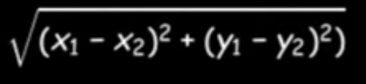
Euclidean Distance Rule:

Slide 4

Brute Force Approach :
- Compare all possible pairs of points.
- Compute the distance for each pair.
- Identify and return the pair with the minimum distance.
Time Complexity of : O($n^{2}$)

Slide 5
Set of Points:

Slide 6
Example :
If input number is 16
Un Sorted Array:
3
2
1
5
6
7
16
13
14
10
9
12
15
4
11
8
Sorted Array:
1
2
3
4
5
6
7
8
9
10
11
12
13
14
15
16
X /Y

Slide 7
Example :
If input number is 16
Un Sorted Array:
3
2
1
5
6
7
16
13
14
10
9
12
15
4
11
8
Sorted Array:
Time complexity for sorting is: O(nlogn)
1
2
3
4
5
6
7
8
9
10
11
12
13
14
15
16
X /Y

Slide 8
1
2
3
4
5
6
7
8
9
10
11
12
13
14
15
16

Slide 9
1
2
3
4
5
6
7
8
9
10
11
12
13
14
15
16
1
2
3
4
5
6
7
8
9
10
11
12
13
14
15
16

Slide 10
1
2
3
4
5
6
7
8
9
10
11
12
13
14
15
16
1
2
3
4
5
6
7
8
9
10
11
12
13
14
15
16
1
2
3
4
5
6
7
8

Slide 11
1
2
3
4
5
6
7
8
9
10
11
12
13
14
15
16
1
2
3
4
5
6
7
8
9
10
11
12
13
14
15
16
1
2
3
4
5
6
7
8
9
10
11
12
13
14
15
16

Slide 12
1
2
3
4
5
6
7
8
9
10
11
12
13
14
15
16
1
2
3
4
5
6
7
8
9
10
11
12
13
14
15
16
1
2
3
4
5
6
7
8
9
10
11
12
13
14
15
16
1
2
3
4
5
6
7
8
9
10
11
12
13
14
15
16

Slide 15
dL
dR

Slide 16
dL
dR

Slide 17
dL
dR

Slide 18

d
d
dL
dR

Slide 19
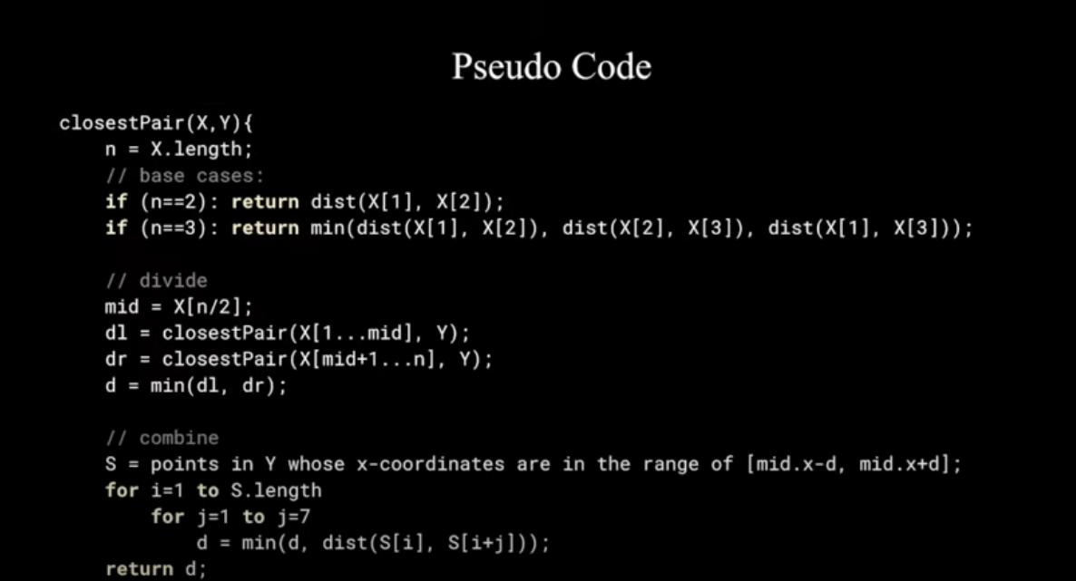

Slide 20
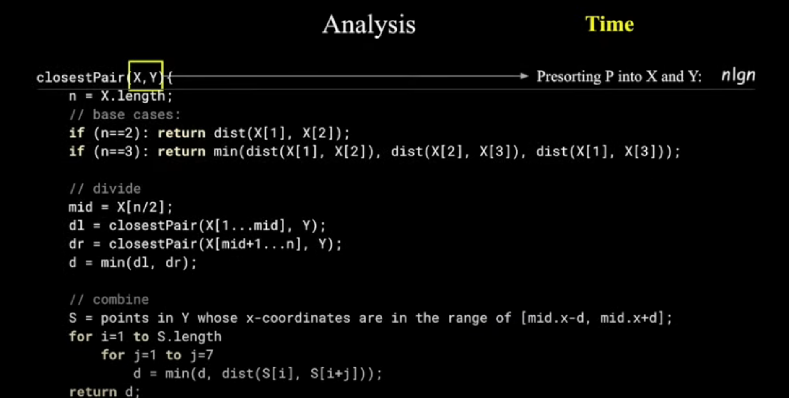
Total Time : O(nlogn)

Slide 21
Thank you

